Slide 1
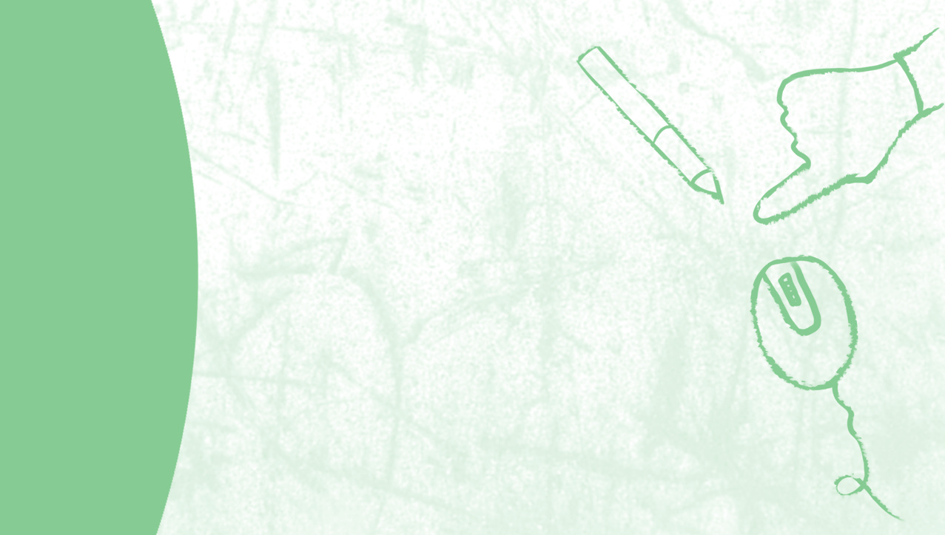
Decision Tree

Slide 2

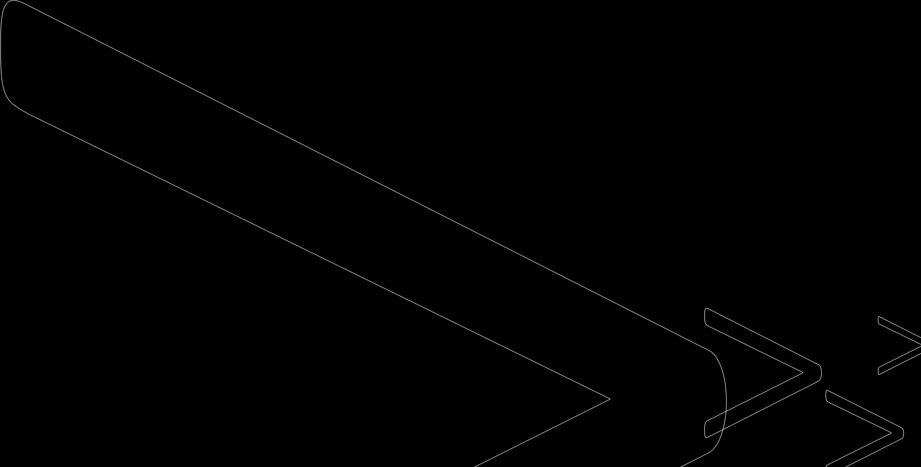
Decision tree
Decision tree algorithm falls under the category of supervised learning. They can be used to solve both regression and classification problems.
Decision tree uses the tree representation to solve the problem in which each leaf node corresponds to a class label and attributes are represented on the internal node of the tree.
We can represent any boolean function on discrete attributes using the decision tree.

Slide 3
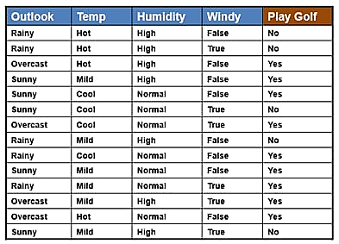
Example

Slide 4
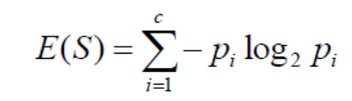
Answer
Entropy is a measure of the randomness in the information being processed. The higher the entropy, the harder it is to draw any conclusions from that information.
Information gain or IG is a statistical property that measures how well a given attribute separates the training examples according to their target classification.

Slide 5
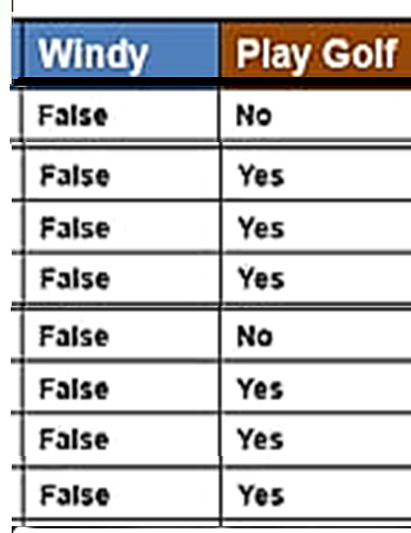
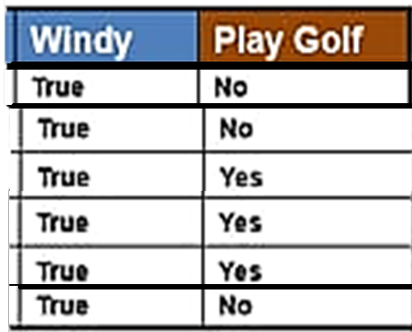

E(wind_F)= - $py .\log_{2}{py}$ - $pn .\log_{2}{pn}$
= - $\frac{6}{8}.\log_{2}{\frac{6}{8}}$ -$\frac{2}{8}.\log_{2}{\frac{2}{8}}$ = .811
E(wind_T)= - $py .\log_{2}{py}$ - $pn .\log_{2}{pn}$
= - $\frac{3}{6}.\log_{2}{\frac{3}{6}}$ -$\frac{3}{6}.\log_{2}{\frac{3}{6}}$ = 1
E(y)= - $\frac{9}{14}.\log_{2}{\frac{9}{14}}$ -$\frac{5}{14}.\log_{2}{\frac{5}{14} }$ = .954
IG(y,wind)=E(y)-$\sum_{i=1}^{k}{Pi.E(}$wind(i))
= .954 - $\frac{8}{14}$ (.811) - $\frac{6}{14}$.1 = .0485
Windy
5N,9y
True
3N,3Y
False
2N,6Y

Slide 6
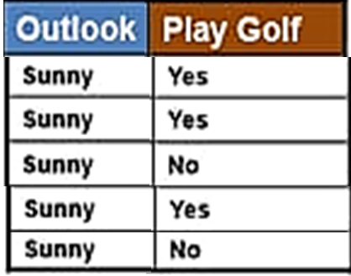
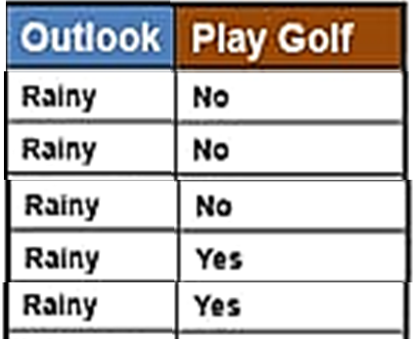
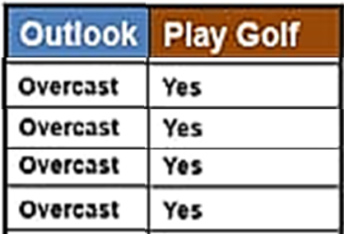

E(Outlook_S)= - $py .\log_{2}{py}$ - $pn .\log_{2}{pn}$
= -$\frac{3}{5}.\log_{2}{\frac{3}{5}}$ -$\frac{2}{5}.\log_{2}{\frac{2}{5}}$ = .971
E(Outlook_O)= - $py .\log_{2}{py}$ - $pn .\log_{2}{pn}$
3
= -$\frac{4}{4}.\log_{2}{\frac{4}{4}}$ = 0
E(Outlook_R)= - $py .\log_{2}{py}$ - $pn .\log_{2}{pn}$
= - $\frac{3}{5}.\log_{2}{\frac{3}{5}}$ -$\frac{2}{5}.\log_{2}{\frac{2}{5}}$ = .971
E(y)= -$\frac{9}{14}.\log_{2}{\frac{9}{14}}$ -$\frac{5}{14}.\log_{2}{\frac{5}{14} }$ = .954
IG(y, Outlook)=E(y)-$\sum_{i=1}^{k}{Pi.E(}$Outlook (i))
= .954 - $\frac{5}{14}$ (.971) - $\frac{4}{14}$.0 - $\frac{5}{14}$ (.971) = .247
Outlook
5N,9y
Sunny
2N,3
Sunny
2N,3Y
Y
Overcast
0N,4Y
Rain
3N,2Y

Slide 7
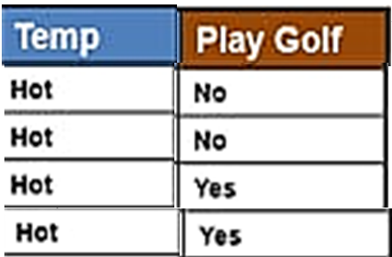
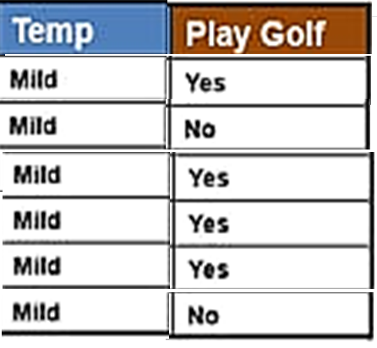
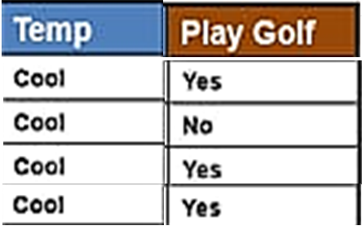

E(Temp _H)= - $py .\log_{2}{py}$ - $pn .\log_{2}{pn}$
= - $\frac{2}{4}.\log_{2}{\frac{2}{4}}$ - $\frac{ 2}{4}.\log_{2}{\frac{2}{4}}$ = 1
E(Temp _M)= - $py .\log_{2}{py}$ - $pn .\log_{2}{pn}$
= - $\frac{2}{6}.\log_{2}{\frac{2}{6}}$ -$\frac{ 4}{6}.\log_{2}{\frac{4}{6}}$ = .92
E(Temp _C)= - $py .\log_{2}{py}$ - $pn .\log_{2}{pn}$
= - $\frac{3}{4}.\log_{2}{\frac{3}{4}}$ -$\frac{1}{4}.\log_{2}{\frac{1}{4}}$ = .81
E(y)= -$\frac{9}{14}.\log_{2}{\frac{9}{14}}$ -$\frac{5}{14}.\log_{2}{\frac{5}{14} }$ = .954
IG(y, Temp )=E(y)-$\sum_{i=1}^{k}{Pi.E(}$ Temp (i))
= .954 - $\frac{4}{14}$ (.81) - $\frac{4}{14}$.1 - $\frac{6}{14}$ (.92) = .042
Tem
5N,9y
Hot
2N,2Y
Mild
2N,4Y
Cool
1N,3Y

Slide 8
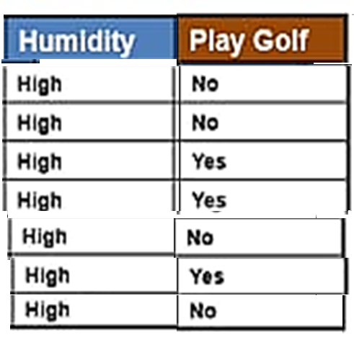
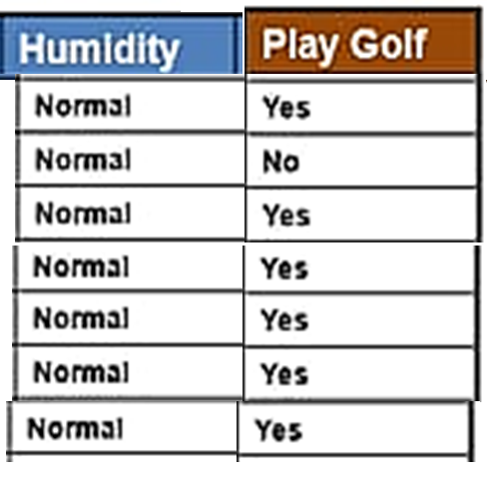

Hum
5N,9y
E(Hum_H)= - $py .\log_{2}{py}$ - $pn .\log_{2}{pn}$
= -$\frac{4}{7}.\log_{2}{\frac{4}{7}}$ -$\frac{3}{7}.\log_{2}{\frac{3}{7}}$ = .985
E(Hum_N)= - $py .\log_{2}{py}$ - $pn .\log_{2}{pn}$
= -$\frac{1}{7}.\log_{2}{\frac{1}{7}}$ -$\frac{6}{7}.\log_{2}{\frac{6}{7}}$ = .592
E(y)= -$\frac{9}{14}.\log_{2}{\frac{9}{14}}$ -$\frac{5}{14}.\log_{2}{\frac{5}{14} }$ = .954
IG(y, Hum)=E(y)-$\sum_{i=1}^{k}{Pi.E(}$Hum (i))
= .954 - $\frac{7}{14}$ (.985) - $\frac{7}{14}(.592)$ = .151
High
4N,3Y
Normal
1N,6Y

Slide 9
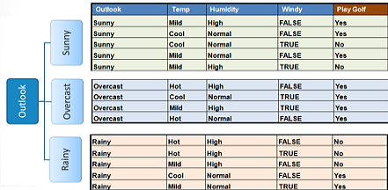
Choose attribute with the largest information gain as the decision node, divide the dataset by its branches and repeat the same process on every branch.
We can see largest information gain is Outlook

Slide 10
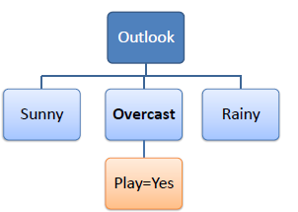

A branch with entropy of 0 is a leaf node.

Slide 11
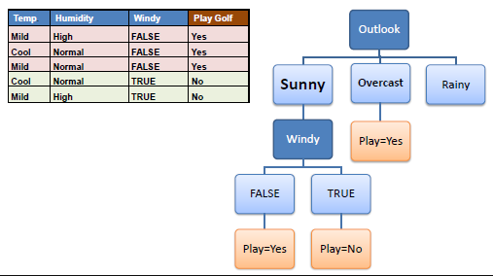
A branch with entropy more than 0 needs further splitting.

Slide 12
Random Forest

Slide 13
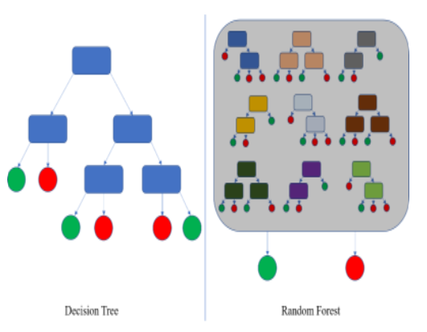
What is Random forest?
Random Forest is an ensemble method that combines multiple decision trees to classify , So the result of random forest is usually better than decision trees.
Random forests is a supervised learning algorithm. It can be used both for classification and regression.
Random forests creates decision trees on randomly selected data samples, gets prediction from each tree and selects the best solution by means of voting.

Slide 14
The Algorithm works in RF
Randomly select some data points from the set
Build decision trees using the selected data points
Select the number of decision trees to be built
Repeat the first and second steps
For any new data point(s), compute the prediction of each decision tree,
and using the majority votes by the trees, assign the new data point(s)
to that class.

Slide 15
Example
Let's consider an example where there are two animals in a dataset , and this is given to a random forest classifier to classify the animals based on certain features.
Each decision tree outputs a decision based on its own computations; the decision trees would have different 'opinions on what the animal is based on certain features. Decision Tree A gives the output that its a giraffe, decision tree B thinks its an elephant and each of the decision trees give their own outputs.
The next step is the majority voting, where each output from a tree is counted and the animal that gets outputted the most is deemed to be the correct animal based on the features. Based on our example, Giraffe was the animal most decision trees predicted; therefore, the random forest assigns this data point to the class of Giraffe.

Slide 16
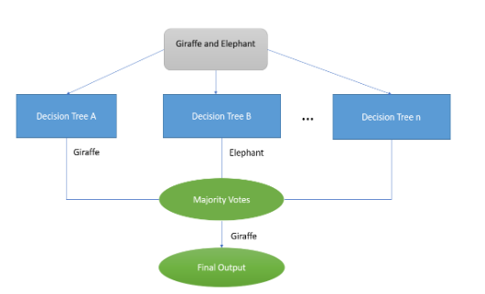
Example Cont.

Slide 17
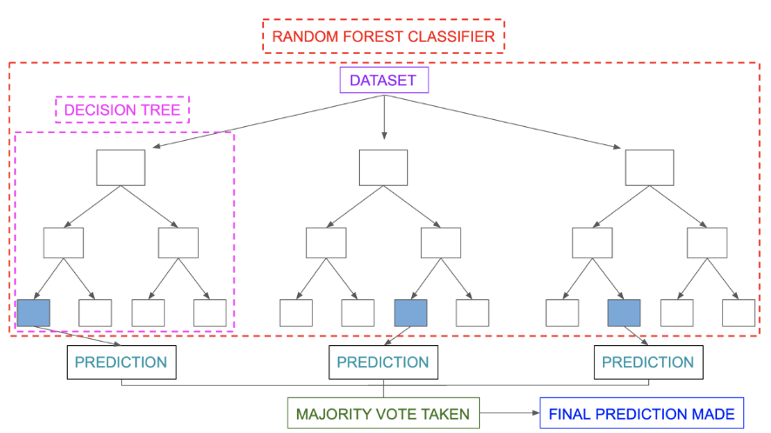

Slide 18
Underfitting and Overfitting
Before diving further let’s understand two important terms:
Bias: Assumptions made by a model to make a function easier to learn.
Variance: If you train your data on training data and obtain a very low error, upon changing the data and then training the same previous model you experience a high error.

Slide 19
Example to Understand Overfitting
The same happens with machine learning; if the algorithm learns from a small part of the data, it is unable to capture the required data points and hence underfitted.
Suppose the model learns the training dataset, like the Y student. They perform very well on the seen dataset but perform badly on unseen data or unknown instances. In such cases, the model is said to be Overfitting.
And if the model performs well with the training dataset and with the test/unseen dataset, like student Z, it is said to be a good fit.

Slide 20
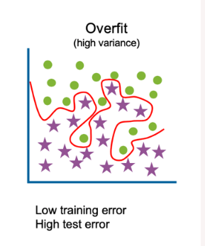
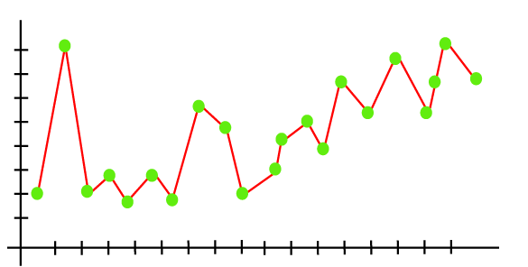
Overfitting
Overfitting occurs when the model fits more data than required, and it tries to capture each datapoint fed to it. Hence it starts capturing noise and inaccurate data from the dataset, which degrades the performance of the model.
An overfitted model doesn't perform accurately with the test/unseen dataset and can’t generalize well.
An overfitted model is said to have low bias and high variance.

Slide 21
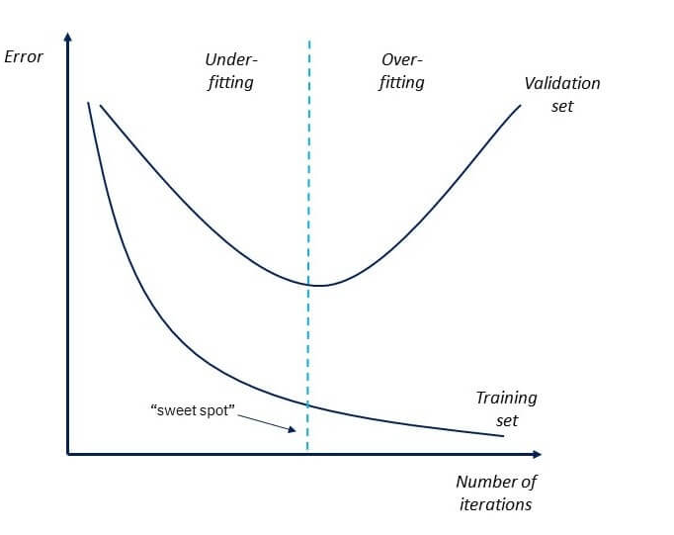
How to Detect Overfitting ?
Now, if the model performs well with the training dataset but not with the test dataset, then it is likely to have an overfitting issue.
For example, if the model shows 85% accuracy with training data and 50% accuracy with the test dataset, it means the model is not performing well.

Slide 22
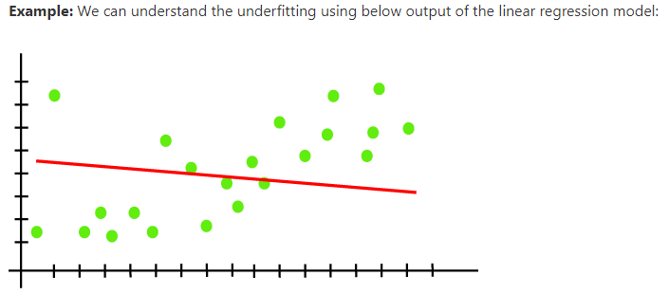
Underfitting?
In the case of underfitting, the model is not able to learn enough from the training data, and hence it reduces the accuracy and produces unreliable predictions.
An underfitted model has high bias and low variance.

Slide 23
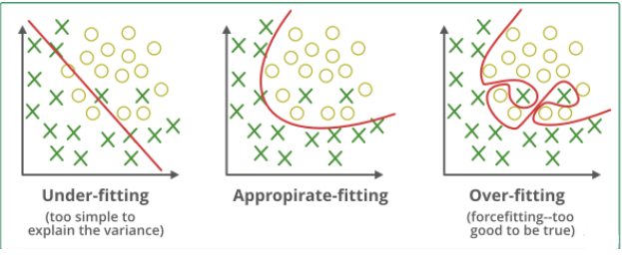
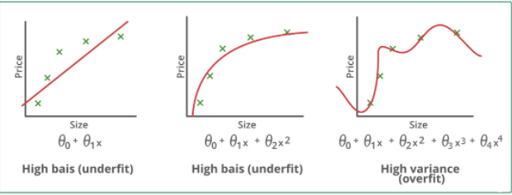
Underfitting and Overfitting

Slide 24


